Slide 1
CONFLICT RESOLUTION
htinaung

Slide 3
CONFLICT
Conflict ဆိုသည္မွာ
ပဋိပကၡ
ဝိေရာဓိ
သေဘာထား ကြဲလြဲမႈ
သေဘာထား ကြဲျပား ဆန္္႔က်င္မႈ
အျငင္းပြားမႈ
ရန္ပြဲ
ျပဒါး တစ္လမ္း သံတစ္လမ္းျဖစ္ျခင္း

Slide 4
CONFLICT
A conflict is more than just a disagreement
ပဋိပကၡသည္ သေဘာကြဲလြဲမႈ ထက္ပိုသည္
Conflicts continue to fester when ignored
လစ္လ်ဴရွဳလ်ွင္ အၾကိတ္အခဲ ၾကီးထြားလာသည္
We respond to conflicts based on perceptions ပဋိပကၡသည္ သိနားလည္ ခံယူခ်က္ေပၚ မူတည္သည္

Slide 5
ပဋိပကၡ
Perceptions are influenced by our life experiences, culture, values, and beliefs
သေဘာထားအျမင္သည္ လူ၏ အေတြ႕အၾကံဳ၊
ယဥ္ေက်းမႈ၊ ယံုၾကည္ခ်က္တို႕ေပၚမူတည္သည္။
Conflicts trigger strong emotions.
ျပင္းထန္ေသာ ခံစားခ်က္မ်ားကို ျဖစ္ေပၚေစသည။္
Conflicts are an opportunity for growth.
တိုးတက္ ၾကီးပြားရန္အတြက္ အခြင့္အလမ္းျဖစ္၏

Slide 7
မွားယြင္းတံု႕ျပန္္မႈ မွန္ကန္ေသာတံု႕ျပန္္မႈႈ
တဖက္သားအား ဂရုမစိုက္
ေပါက္ကြဲ ေဒါသထြက္သည္။
နာက်င္ေစမႈ၊ ခါးသည္းမႈျဖစ္
အဆက္ျဖတ္၊ ပစ္ပယ္သည္၊ ခြဲျခားခြဲျခား၊အရွက္ရေစသည္။
တစ္ဖက္သားႏွင့္အေပးအယူမလုပ္။
ေတြ႔ဆံုေျဖရွင္းျခင္းအားျဖင့္ ပိုမိုဆိုးဝါးေသာ ရလက္မ်ားကို ေၾကာက္ရြံ႕ျခင္း။
ခံစားခ်က္ကို အေလးထား။
ေအးျငိမ္း၊ ေလးစားသည္။
ျငင္းခ်က္ကင္းသည္။
နားလည္ခြင့္လႊတ္လ်က္ ေရွ႕သို႔ခ်ီတက္သည္။
အေပးအယူလုပ္သည္၊ အျပစ္မေျပာ။
ေတြ႔ဆံုေျဖရွင္းျခင္းသည္ ႏွစ္ဦးႏွစ္ဖက္အက်ိဳးမ်ားသည္ ကိုသိသည္။

Slide 8
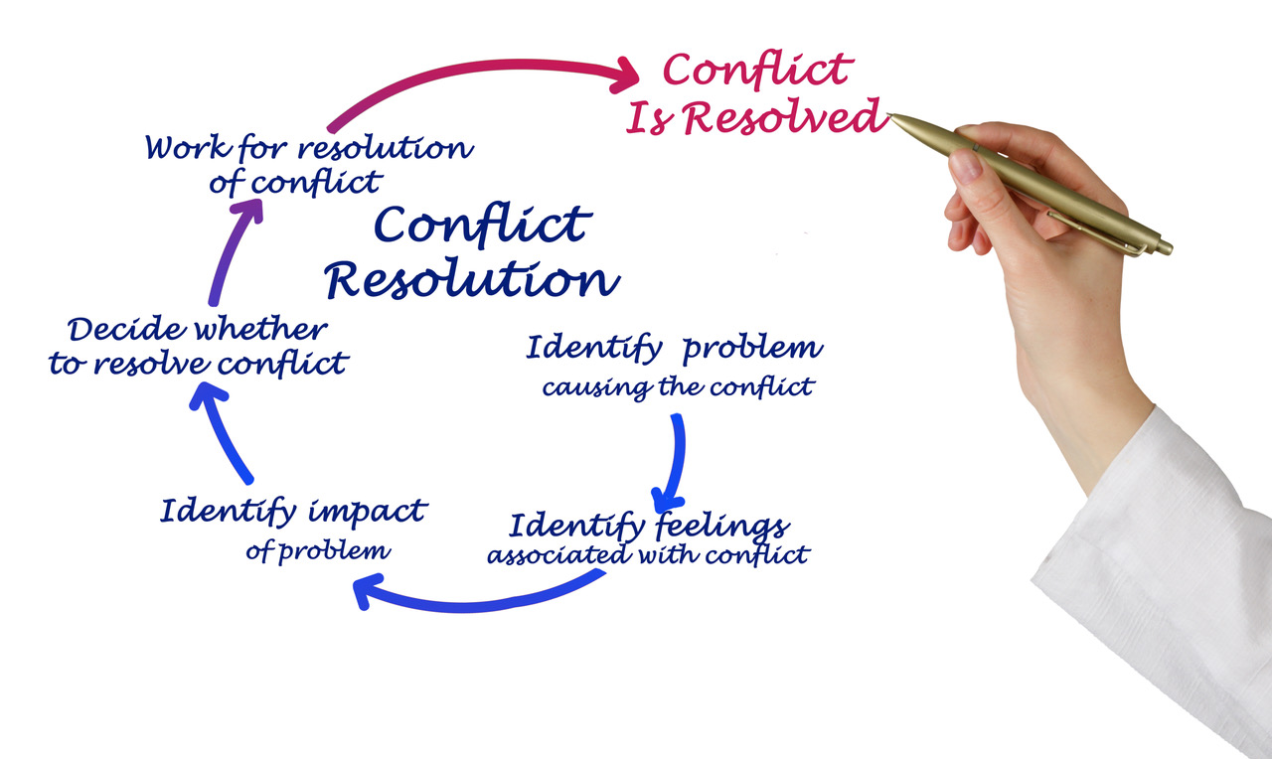
COFLICT RESOLUTION

Slide 9
CONFLICT RESOLUTION PROCES
Recognition by the parties - problem exists.
ျပႆနာရွိသည္ ကိုလက္ခံျခင္း။
Mutual agreement - find some resolution.
အေျဖရွာရန္ သေဘာတူညီျခင္း။
An effort to understand the perspective and concerns of the opposing individual or group
တစ္ဖက္သား၏ အခက္အခဲကို နားလည္ေအာင္ အားထုတ္ျခင္း။
Identifying changes- lessen negative feelings (attitude, behavior, and approaches to work)
ေျပာင္းလႊဲရမည့္ ကိစၥမ်ား၊ အႏုတ္လကၡာဏျပ ခံစားခ်က္မ်ား
ကိုစီစစ္ျခင္း။
Recognizing triggers of conflict.
ပဋိပကၡ၏ ခလုတ္စနစ္မ်ားကို ေတြ႔ျမင္ေအာင္သံုးသပ္ျခင္။

Slide 10
CONFLICT RESOLUTION PROCESS
Interventions by third parties [higher level]
တတိယ ပါတီ တပါးသူ၏ ျဖန္ေျဖမႈကိုလက္ခံျခင္း။
A willingness to compromise.
အေပးအယူ ျပဳလုပ္ရန္ ဆႏၵျဖစ္ေပၚေစျခင္း။
Agreement on a plan to address differences.
ကြဲျပားမႈမ်ားအား ညွိႏွႈိင္းေျဖရွာရန္ စီမံခ်က္ခ်ျခင္း။
Monitoring the impact of agreements
သေဘာတူညီခ်က္၏ တိုးတက္မႈကို အစဥ္တစုိက္ မွတ္သားျခင္း။
Disciplining or terminating employees who resist efforts to defuse conflicts.
ပဋိပကၡေျဖရွင္းရန္ ေခါင္းမာေနသူအား အေရးယူျခင္း။

Slide 11
QUALITIES FOR RESOLUTION
The ability to successfully resolve conflict depends on your ability to:
Manage stress quickly. Remaining calm.
ဖိစီးမႈအား ကိုင္တြယ္ျခင္း။ ေခါင္းေအးေအးထားျခင္း။
Control your emotions and behavior. [communicate without threatening, intimidating, or punishing others]
မိမိ၏ ခံစားခ်က္မ်ားႏွင့္ အျပဳအမူကို ထိမ္းသိမ္းျခင္း။
Pay attention to the feelings being expressed
ေဖာ္က်ဴးေသာ ခံစားခ်က္မ်ားကို အေလးထားျခင္း။
Be aware of and respect differences
ျခားနားခ်က္ အျမင္မတူမႈမ်ားကို အသိရွိေနျခင္း။

Slide 12
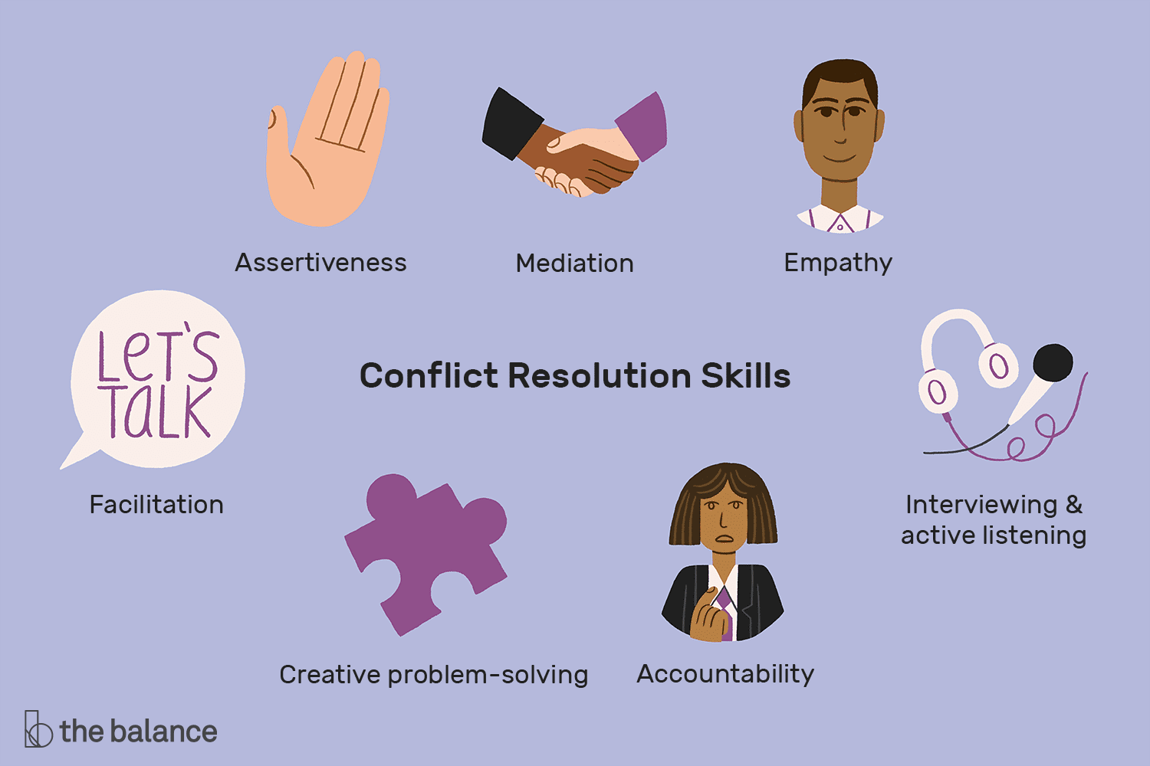
CONFLICT RESOLUTION STRATEGIES

Slide 13
QUALITIES
EMPATHY: It’s the ability to step into the shoes of another person, aiming to understand their feelings and perspectives, and to use that understanding to guide our actions
ကိုယ္ျခင္းစာနာမႈ။ တျခားလူ၏ခံစားခ်က္ ယံုၾကည္ခ်က္မ်ားကို နားလည္ေအာင္ျပဳလုပ္ျခင္း၊ ထိုနားလည္မႈက မိမိ၏ အျပဳအမႈကို လမ္းညႊန္ျခင္း။

Slide 14
QUALITIES
CREATIVE PROBLEM SOLVING: cps is a process that involves breaking down a problem to understand it, generating ideas to solve the problem and evaluating those ideas to find the most effective solutions.
ဖန္တီးျခင္းပါေသာ ျပႆနာေျဖရွင္းမႈ။
ျပႆနာကို အပိုင္းပိုင္း ျဖတ္ေတာက္ျခင္း၊
အပိုင္းမ်ားကိုနားလည္ျခင္း၊ အေျဖမ်ား ရွာၾကံျခင္း၊
အထိေရာက္ဆံုးအေျဖမ်ားကိုေရြးခ်ယ္ျခင္း ။

Slide 15
BACK STABBING ေနာက္ေက်ာ ဓါးႏွင့္ မထိုးပါႏွင့္

Slide 17
PROBLEM ONE
It was at a medical school.
Some of the student in Semester Four fall short of the 75% attendance need.
The Dean with the blessing of some HoDs debarred a number of student.
It was not a small number [about 1/5 of the class]
Parents are concerned, distressed and some voice moving their children to other medschools.

Slide 18
PROBLEM TWO.
It was at a medical school.
The Head of Department of a certain department is a stickler to regulation.
Departmental staff was well loved by students because they teach extremely well.
On non-teaching days the teachers (in fact) were merry making.
The Head of Department sent out notices.
Department staff sent a complaint letter to Dean saying the HoD is too harsh.

Slide 19
PROBLEM THREE
It was at a certain department of a medical school.
There were something like twelve teaching staff.
APs and Senior lecturers are at odds on a particular question at departmental vetting.
APs thinks the questions are a bit tough.
Senior lecturer maintained it was for quality.

